Slide 1
Exploratory Analysis of Mesa County Public Health
By Kurtis Bulock

Slide 2
Observations
Representation of Race Survey vs. County.
Loneliness vs. Social Conflict:
All ages
Children
Household Income vs. Household Danger.
Household Income vs. Social Conflict.
Future Work
Possible continued observations.
How this information can be used for future action.

Slide 3
Racial Representation (single race)
Race | Survey Representation | County Representation
Asian | 0.742% | 1.036%
Black/African American | 1.372% | 0.948%
Native American/Alaska Native | 5.193% | 1.534%
Native Hawaiian/Other Pacific Islander | 0.297% | 0.137%
White | 92.40% | 93.94%
Native American/Alaska Natives overrepresented
Other races are nearly accurately represented

Slide 4
Racial Representation Future Work
Educate the public on minorities in the community.
How does the diversity of CMU compare to the rest of the County?
How does diversity in Mesa County compare to other Colorado counties?

Slide 5
Loneliness and Social Conflict
Loneliness is reported by Supplemental Need Family & Community Support Question.
Loneliness is measured on the following scale:
[0] NEVER
[1] RARELY
[2] SOMETIMES
[3] FAIRLY OFTEN
[4] ALWAYS
Social Conflict is measured out of a total of 16 by adding all of the Core Need Safety Questions: 1-4.
CN_SF_1-4 are measured by the following scale:
[0] NEVER
[1] RARELY
[2] SOMETIMES
[3] FAIRLY OFTEN
[4] FREQUENTLY

Slide 6
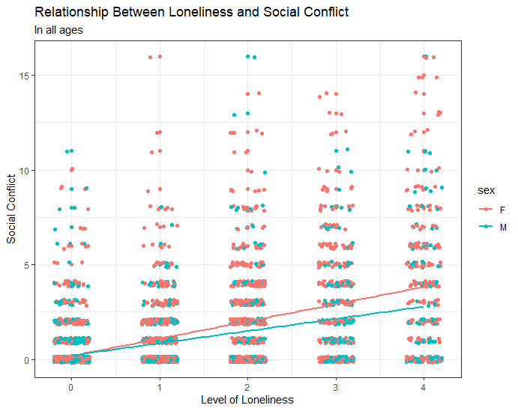
Loneliness and Social Conflict
Higher social conflict correlates with a higher feeling of loneliness
Reporting higher loneliness in women

Slide 7
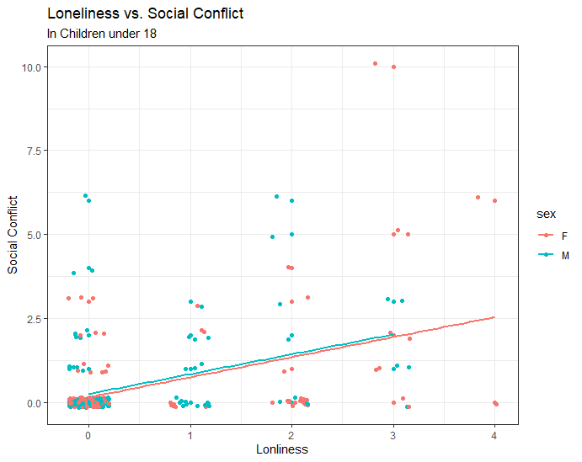
Loneliness and Social Conflict in Children
Similar trend in children
Data pool much smaller

Slide 8
Loneliness and Social Conflict Future Work
Loneliness impact on mental health.
Better recognize social conflict’s affect on mental health.
Can machine learning techniques be applied to accurately predict loneliness in individuals?

Slide 9
Household Income and household dangers
Income reported by Tell Me About Yourself: Question 6
LESS_THN_10K;
MORE_THN_10_LESS_THEN_15K
MORE_THN_15_LESS_THEN_20K
MORE_THN_20_LESS_THEN_25K
MORE_THN_25_LESS_THEN_35K
MORE_THN_35_LESS_THEN_50K
MORE_THN_50_LESS_THEN_75K
MORE_THN_75K
Household Danger measured by Core Need Living Situation: Question 2
Do you have problems with…? [1] Yes, [2] No, [7] Total
Bug Infestation
Mold
Lead Paint
Inadequate Heat
Oven (not Working)
Smoke Detector (not Working)
Water Leaks

Slide 10
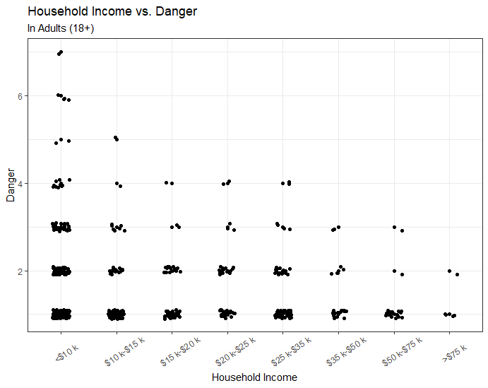
Household Income and Household Dangers
Less Income = More Danger
Intuitive conclusion

Slide 11
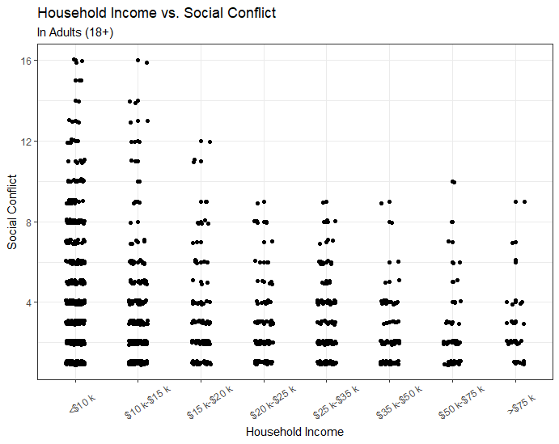
Household Income and Social Conflict
Less significant correlation
Plateaus after $20k

Slide 12
Household Income Future work
Income can be a factor in overall individual health. (Food/Transportation/Housing)
Identify low income populations to better employ social services

Slide 13
Tools / Resources
Tools
R/Rstudio
Ggplot2
Tidyverse
Dplyr
Knitr
Excel
Resources
Interview_data.csv (Raw Data)
Interview_data_dict.csv (Data Dictionary)
Accountable Health Communities Model Screening Tool.docx (Survey)
www.Census.gov (Mesa County Population estimates)

Slide 14
Rmarkdown / Github
Similar presentation written Rmarkdown for reproducibility
Download or view all code at https://github.com/kurtisbu/Mesa-County-Data

Slide 15

Thank you
Questions?

